Slide 1
Slaviša Đurđić
ATP Top-Ranked Singles Tennis Players
Goal: Analysis of the Tableau “ATP Top-Ranked Singles Tennis Players” sports sample dataset for period 1973-2018.
Instructions:
- Collect data by downloading the CSV file from https://public.tableau.com/app/learn/sample-data?qt-overview_resources=1#qt-overview_resources.
- Use SQL queries to load the data to MySQL table(s).
- Execute some basic SQL queries.
- Build visuals in Tableau (https://public.tableau.com/app/profile/slavisadurdic/viz/ATPRankingSingles/ATPDashboard).
Belgrade, September 2023

Slide 2
MySQL queries
USE data_analysis;
CREATE TABLE atp (
player VARCHAR(50),
DOB VARCHAR(50),
cumulative_weeks INT,
w_date VARCHAR(50),
sex VARCHAR(10),
weeks INT,
age_days INT,
age_years INT,
age_decimal DECIMAL(5,2)
);
LOAD DATA INFILE "atp_number_1.csv"
INTO TABLE atp
FIELDS TERMINATED BY ','
LINES TERMINATED BY '\n'
IGNORE 1 ROWS;

Slide 3
MySQL queries
WITH cte AS (
SELECT player, DOB, cumulative_weeks, w_date, sex, weeks, age_days, age_years, age_decimal,
ROW_NUMBER() OVER(PARTITION BY player, DOB, cumulative_weeks, w_date, sex, weeks, age_days, age_years, age_decimal) AS RN
FROM data_analysis.atp
)
SELECT *
FROM cte
WHERE RN > 1;

Slide 4
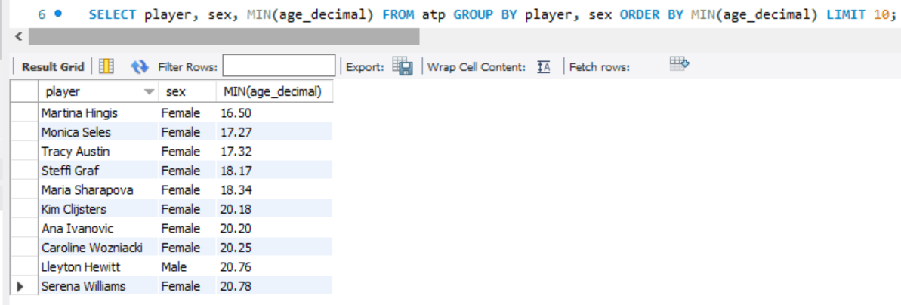
MySQL queries
10 youngest number one tennis players from 1973 to 2018.

Slide 5
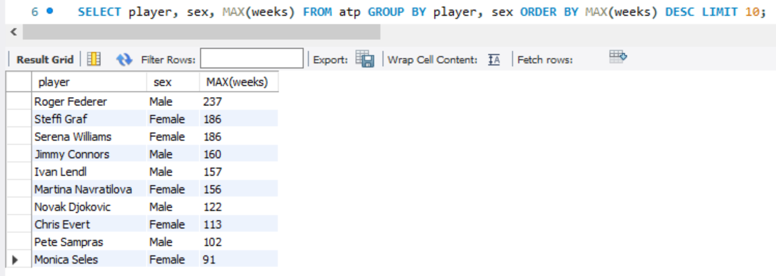
MySQL queries
10 tennis players from 1973 to 2018 with a best score of consecutive weeks as ATP number one.

Slide 6

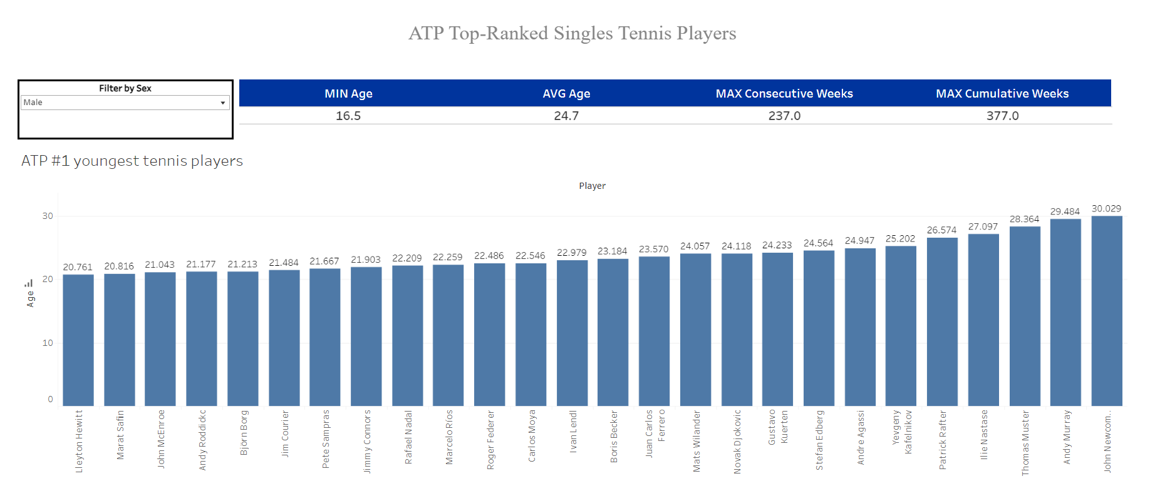

Slide 7
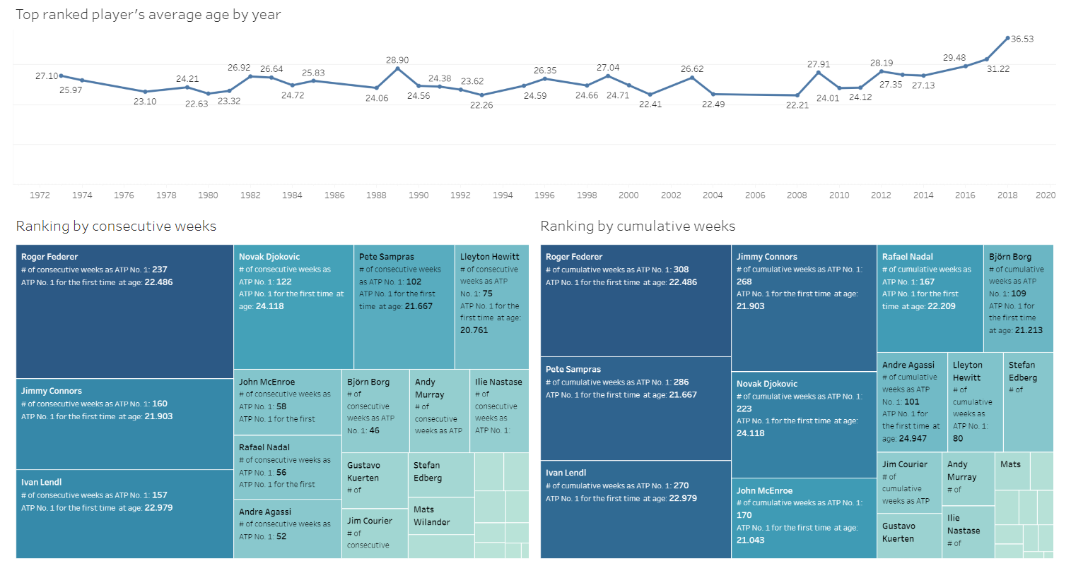

Slide 8
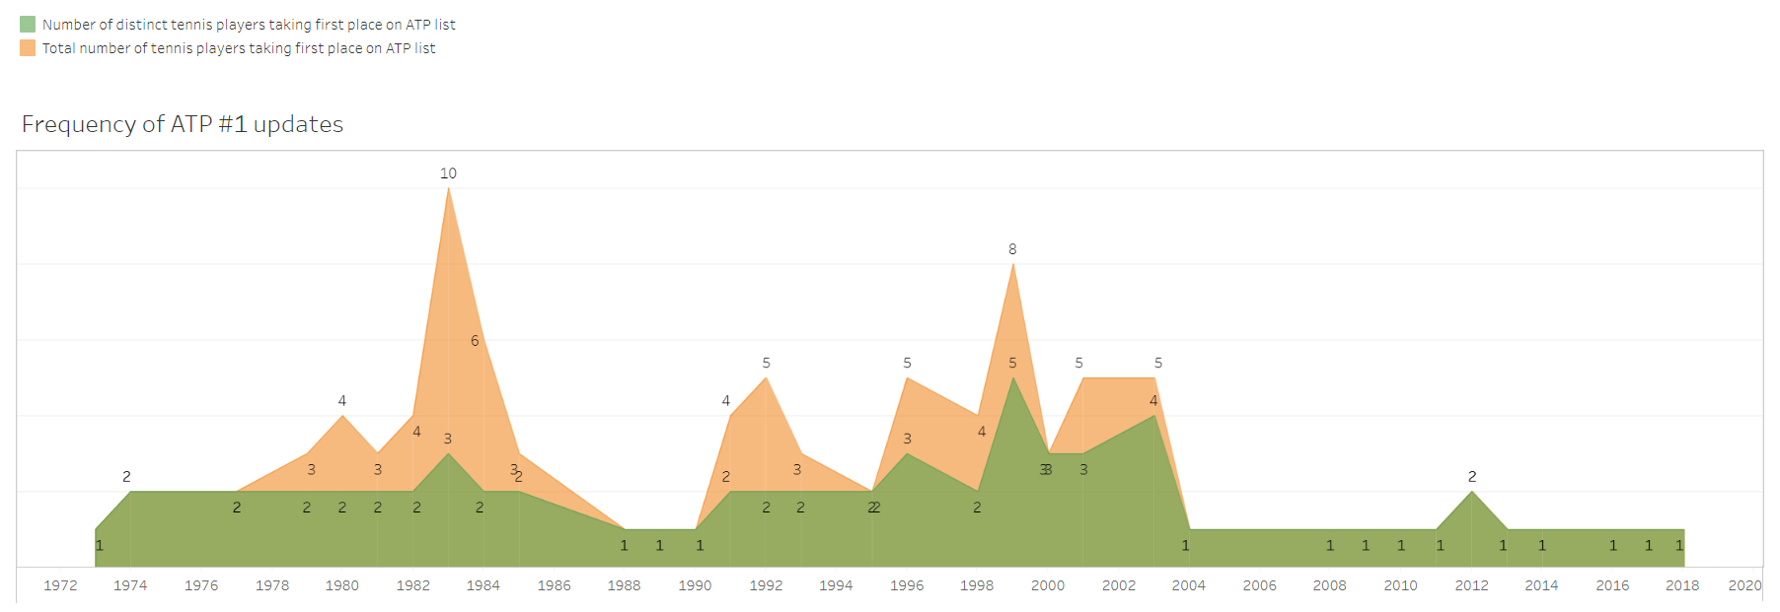

Slide 9
ATP Number 1 Project Insights
1) The youngest ATP (male) number one tennis player between 1973 and 2018 was Lleyton Hewitt (age 20.76), while the youngest WTA (female) number one tennis player for the same period was Martina Hingis (age 16.5).
2) Average age of all tennis players ranked as number one for the period 1973-2018 was 24.7.
3) Roger Federer was the best tennis player during the observed period in terms of number of consecutive weeks (=237) holding first place on the list.
4) Steffi Graf was the best tennis player during the observed period in terms of total number of weeks (=337) holding first place on the list.
5) WTA number one position was unstable most in year 1995 (3 players interchangeably switched No. 1 position for 8 times), while ATP number one position was disturbed most in year 1983 (3 players interchangeably switched No. 1 position for 10 times).

